Slide 1



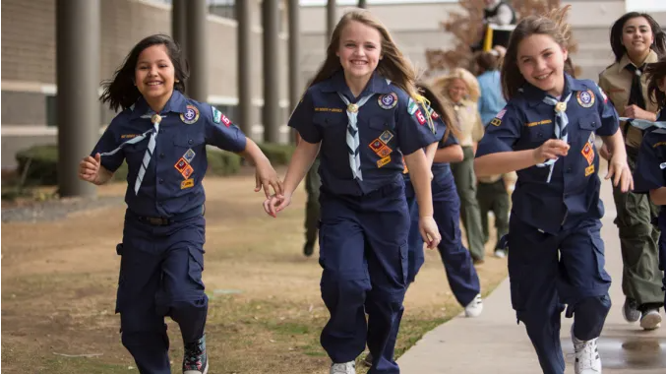

Scouting is on the move with your support!!
Notes:
Good evening. Thank you for allowing me to come and speak to you today. My name is _________________ and I am here tonight to tell you that Scouting is alive and well in the Laurel Highlands Council. During the next few minutes, I will discuss how Scouting in the Laurel Highlands Council is moving forward.

Slide 2


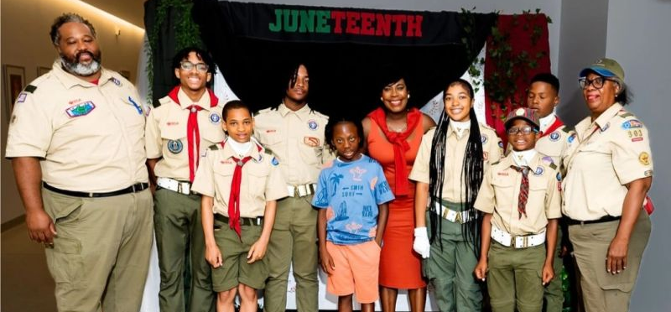


Who we are
8,000+ Youth
350 Scouting Units
19 counties in 3 states (MD, PA, WV)
6 camps (Anawanna, Baker, Guyasuta, Heritage, Potomac, & Seph Mack)
Notes:
The Laurel Highlands Council covers a large portion of South-West Pennsylvania as well as portions of Maryland and West Virginia, representing over 8,500 Scouts. We operate both the Pittsburgh and Johnstown Service Centers and SIX camping facilities throughout our council.

Slide 3

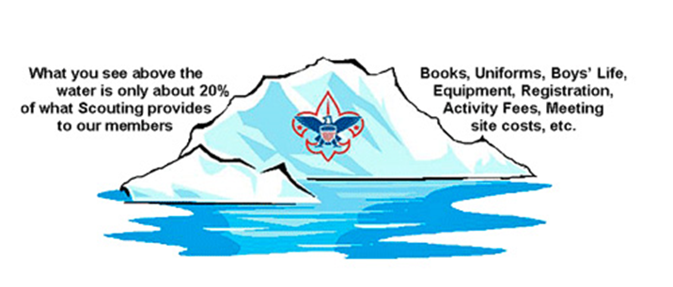
What does the Laurel Highlands Council do?
The Laurel Highlands Council provides…
Top-notch camping facilities at SIX camps
Insurance coverage to protect volunteers, chartered organizations, staff members, and properties.
Camperships, uniforms, and membership financial support for disadvantaged youth.
Camp equipment, like tents, cooking equipment, camp vehicles, building repairs, canoes, equipment replacement and repair, and general upkeep of council camps.
Year-round volunteer and staff basic training – FREE to all registered leaders
Council communications – website, emails, newsletters, mailings, etc.
Staff of Scouting Professionals to support volunteers
Administrative support including postage, computers, and links to the National BSA computer system, copy machines, folding machines, and a printing shop.
Pittsburgh and Johnstown Scout Shops
Camp Rangers and summer camp staff
Notes:
What does the Laurel Highlands Council do? Well, here are just a few examples…
(point out two or three that best pertain to the group being addressed)

Slide 4
Community Impact
Over 50 units provided over 1,650 hours in the Scouting for Food program, collecting 13,229 pounds of food
Our Scouts provided over 2,925 hours supporting Veterans and 2,300 hours on conservation projects
The average number of Community Service Hours this past year was 4.35 hours per Scout
218 Eagle Scouts had over 35,000 hours of service to their communities through their Eagle Projects
Notes:
The concept of Scouting 365 is simple: Scouting Every Day In Some Way. This motto embodies the LHC’s commitment to living life the Scout way, which ultimately benefits our communities.
It means that even when they’re not directly participating in Scouting activities, Scouts will find minor and major ways to use their skills, help other people, keep themselves physically and mentally healthy, and demonstrate a firm moral compass. This includes not only doing the right thing and honoring your beliefs, but treating all people with respect and being an active participant in their community.

Slide 5
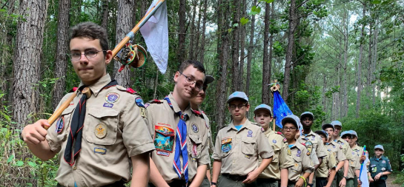
2026 Challenges
Continue to contend with the rising costs of:
  Insurance
  Camp operations
  Facilities and staff
Fundraising
  Friends of Scouting
  Corporate sponsorships
  Expanding unit participation
Recruiting
  School access to build Cub Packs
  Additional families
  Additional adult leaders
  Additional and different units
Rebranding as Scouting America.
Notes:
But there are challenges to face and overcome.
Just like every household in our council, we are dealing with the increased costs of just about everything including insurance, basic operating costs at our offices and camps, and food and supplies for summer camp.
Other challenges include, increasing school access to aid our recruitment efforts, and replacing the $2.5 Million taken from our Endowment Fund to pay our portion of the BSA’s bankruptcy settlement.

Slide 6
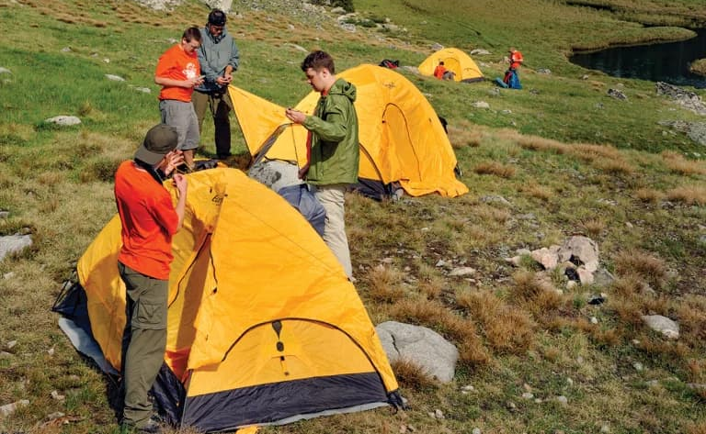
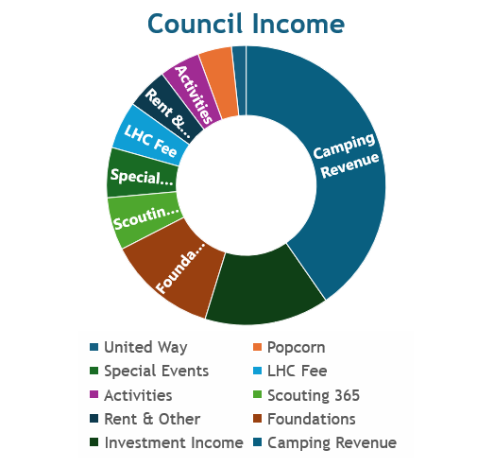
Where your $dollar goes
90% OF COUNCIL EXPENSES DIRECTLY SUPPORT THE PROGRAM FOR OUR SCOUTS. (8% supports fundraising efforts and 2% into general expenses)
Notes:
You may be asking how we are able to accomplish all of this. The Laurel Highlands Council has a strong financial base that we build off of. This graphic shows how our council is funded. Of special note, our combined Scouting 365 campaigns provide 6% of our operating budget. The $53.00 LHC fee we collect when our youth and adults register provides roughly 5.5%. When you consider our council spends approximately $750 to support just one Scout each year, that leaves us with the challenge of raising roughly an additional $700 for each Scout in our program.
Your contribution to the Scouting 365 campaign has a profound impact on our Scouts. They enable us to provide high-quality programs, maintain our campgrounds, and offer financial assistance to those who may not have the means to participate otherwise. Without your support, many of the great experiences your child has in Cub Scouts would not be possible.
This year, our goal for our Scouting 365 campaign is to raise $365,000 across the council. This may seem like a lot, but when we break it down across all our families, it becomes an achievable target. Every dollar counts, and together, we can make a difference.

Slide 7
Summary
The Scouting Program is alive and well in the Laurel Highlands Council!
Keys to future success:
Continue to build on the foundations of our program: The Scout Oath and Law.
Create sustainable fundraising efforts that will continue to grow from year to year.
Continue to rebuild and retain our membership, especially in Cub Scouting.
Provide our youth with the resources and facilities they need to have an enjoyable and successful experience.
Recruit and train new adult leaders and retain experienced and proven adult leaders in our units.
Notes:
I’d like to now ask all of you to take a minute and consider making a contribution to the Scouting 365 Unit Campaign. You can do so in a few ways using your pledge card or by scanning the QR code at the bottom:
1. One-time Donation: You can make a one-time donation today.
2. Pledge: You can pledge a specific amount and make contributions in installments.
3. Corporate Matching: Check with your employer to see if they offer a corporate matching program, which can double your impact.
We want to acknowledge your generosity. Those who contribute to Scouting 365 today will receive a LHC carabiner, and we'll keep you updated on our progress throughout the year. Those that are able to give at the $365 will receive a special Scouting 365 council strip.
After I finish, a few of your Scouts will be collecting your pledge cards. Please fill out your card and give it to them even if you are unable to give at this time.

Slide 8
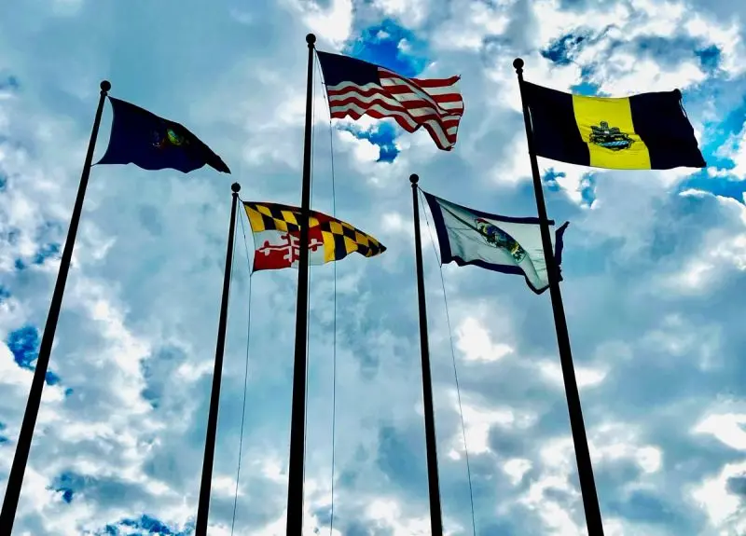
QUESTIONS?
&
THANK YOU!
for your continued support of Scouting in the Laurel Highlands Council!
Notes:
Now, I'll take a moment to answer any questions you may have about the council or Scouting 365.
Thank you for your time and your commitment to Scouting. Together, we can continue to provide a fantastic Scouting experience for our Scouts. Your support truly makes a difference.

