Slide 1
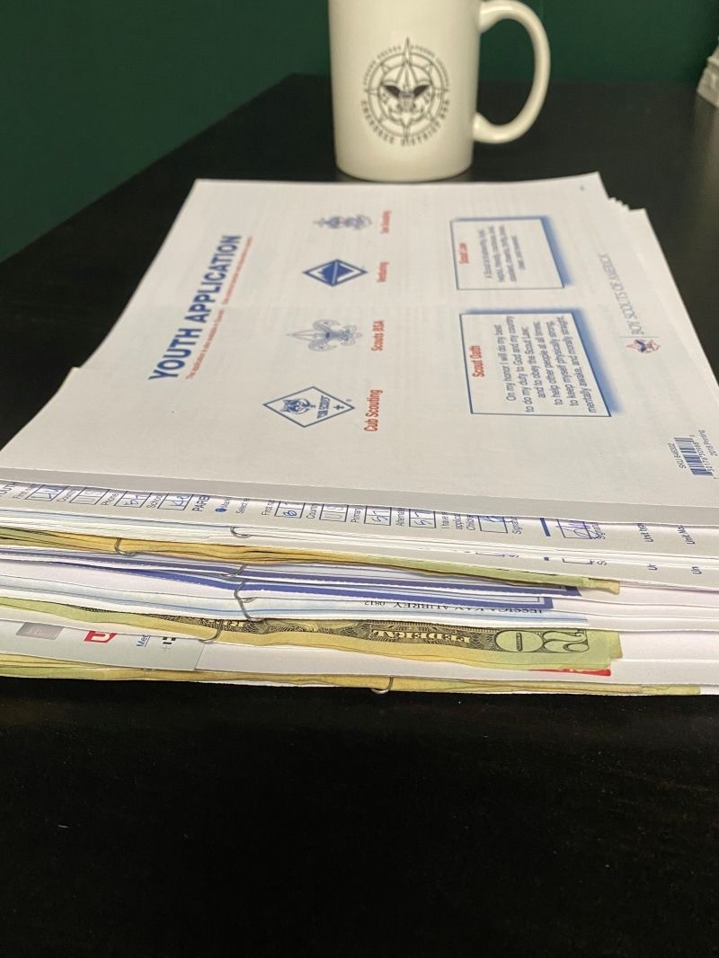

Times are Changing
1

Slide 2
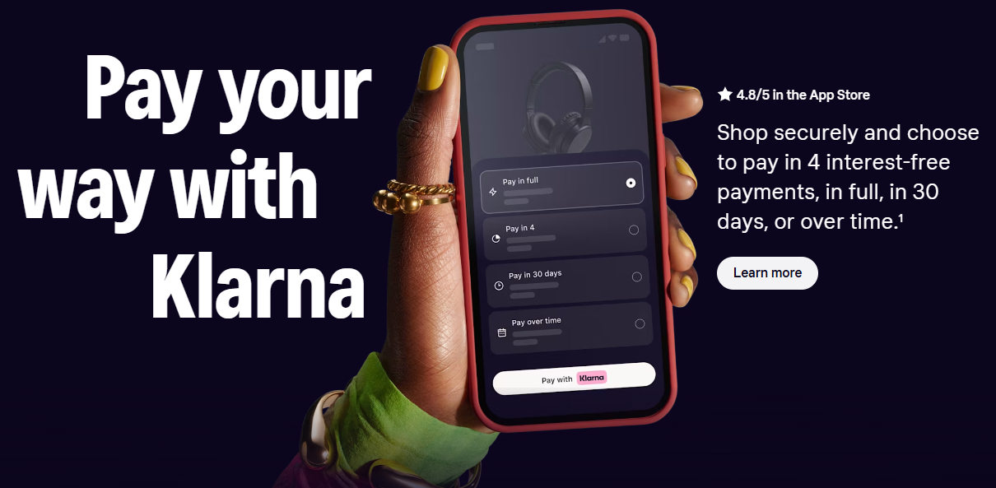
Buy Now Pay Later - Pilot
2

Slide 3
Buy Now Pay Later - Pilot
This is just like a Credit Card purchase
The Council has no paperwork or dealings with Klarna
The arrangement is between the parent and Klarna
We anticipate that three to five percent of parents will choose this option
3

Slide 4
Buy Now Pay Later - Pilot
Cost to Scouting – .89% above the current 3% Admin Fee we currently charge. (Average of $1.16 per member).
  National is covering this cost during the Pilot.
It’s just an additional payment option for the parent, in addition to a Credit Card, Google Pay, or Apple Pay.
Choose to pay in 30 days, and there is no additional cost to the parent.
Spread the payment over 4 installments within six weeks, and there is no additional cost to the parent.
Choose to extend the payment plan (3, 6, or 12 months), and the parent is charged interest of between 8% – 35.99% APR.
4

Slide 5
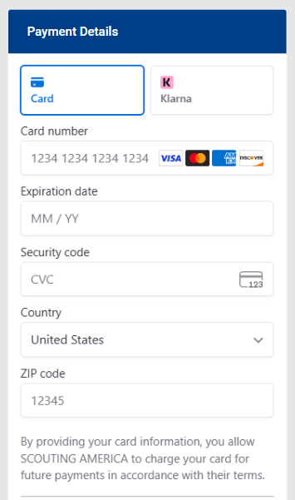
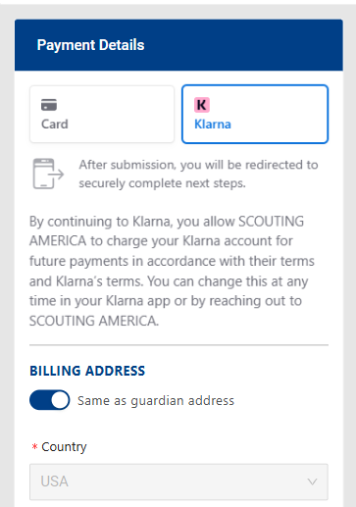
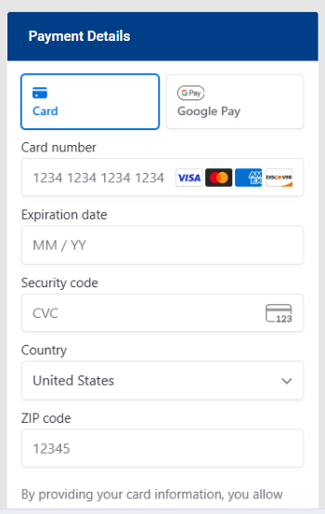
Buy Now Pay Later - Pilot
Online Registration Today
Sample Payment Screen with Klarna
5

Slide 6
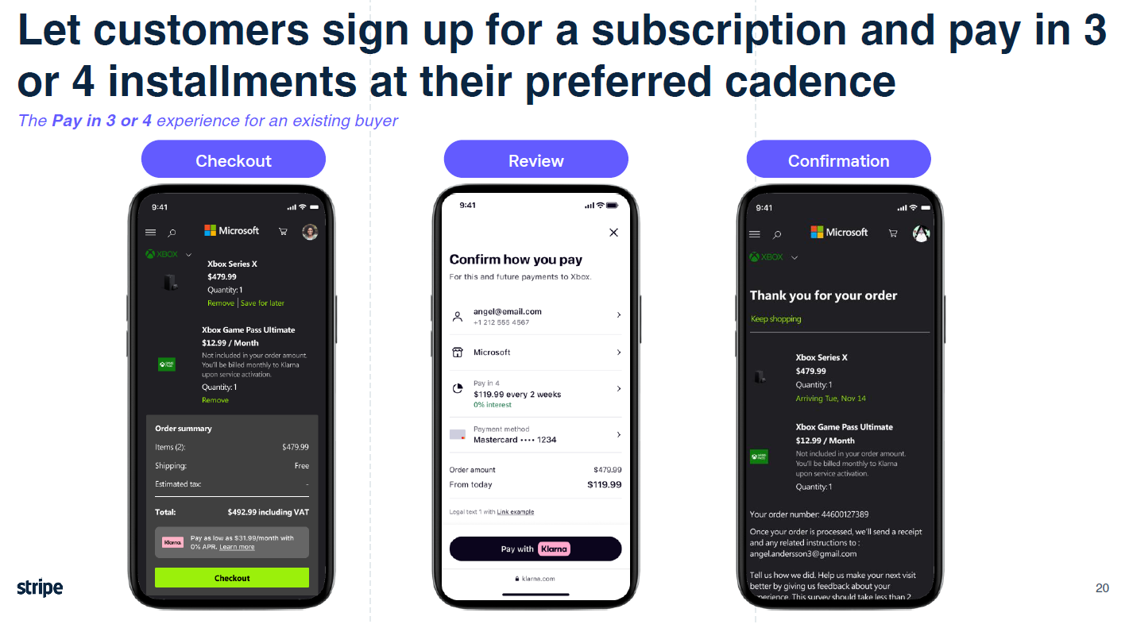
Buy Now Pay Later - Pilot
6

Slide 7
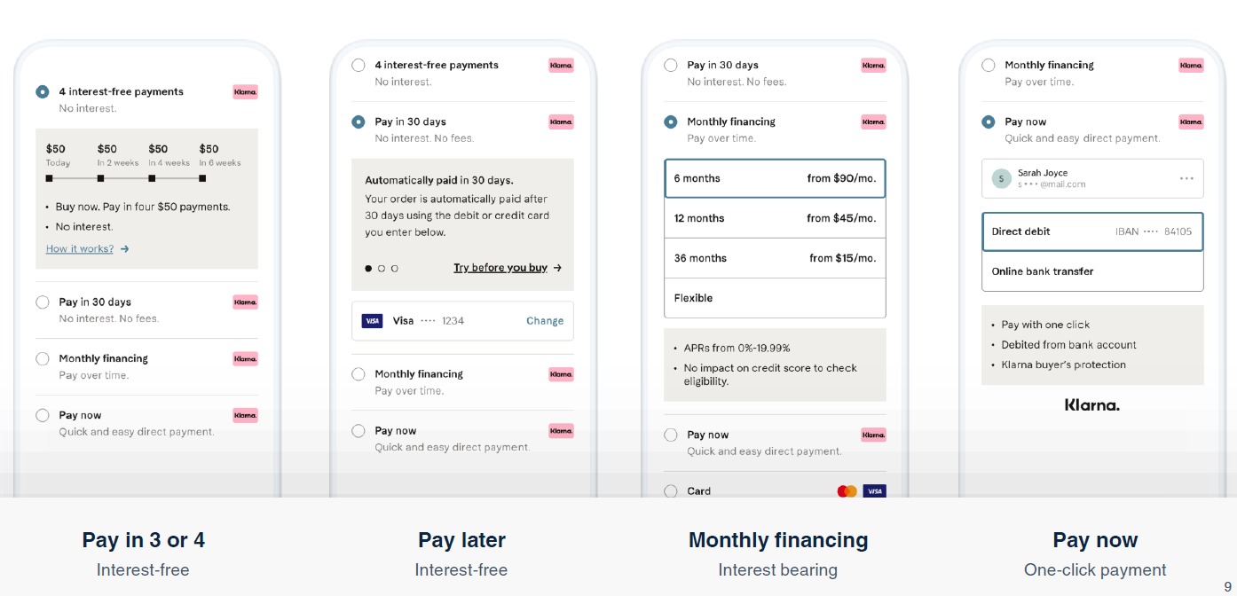
Buy Now Pay Later - Pilot
7

Slide 8
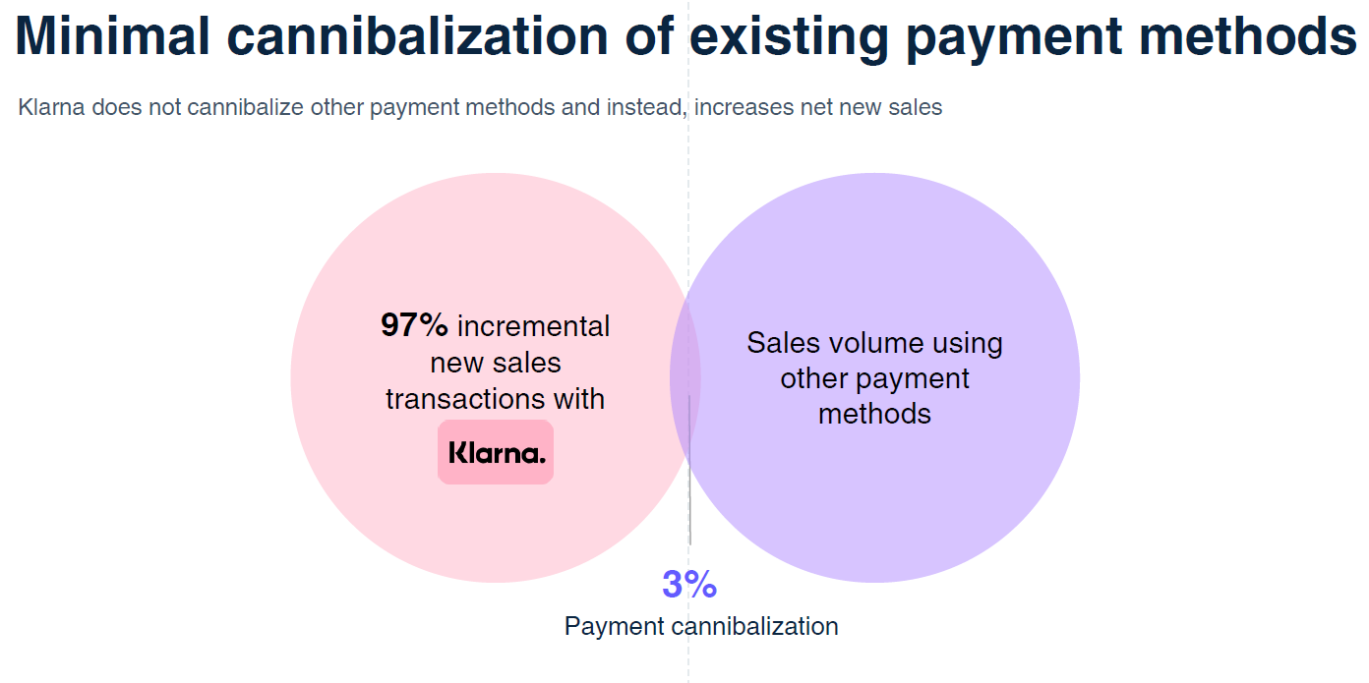
Buy Now Pay Later - Pilot
8

Slide 9
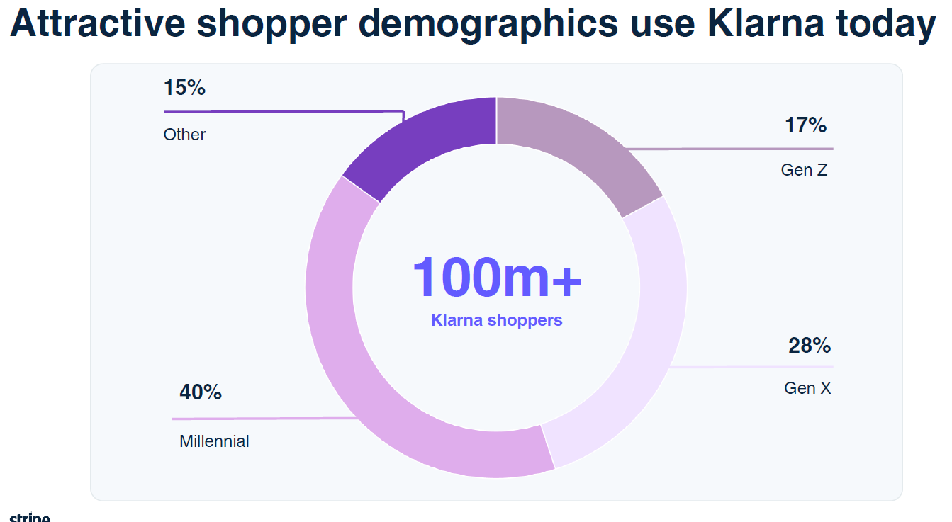
Buy Now Pay Later - Pilot
9

Slide 10
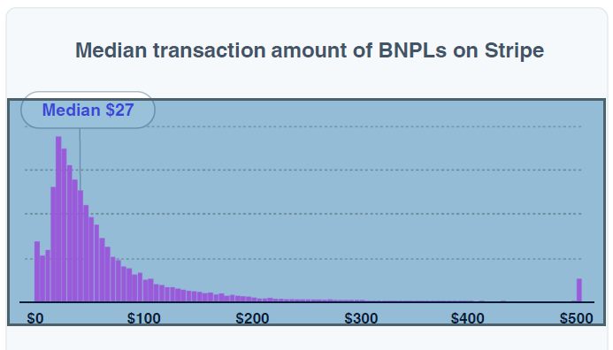
Buy Now Pay Later - Pilot
10

