Slide 1





Best Partner for Councils
…. making life easier for you!

Slide 2
Sales

Slide 3
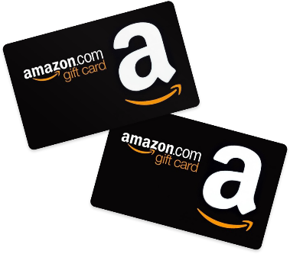
Trail’s End Rewards
BENEFITS FOR COUNCILS
  Save money with 1.5% Trail’s End Rewards cost vs. 3.5% physical prize program.
  Save time by not having to review prize orders.
  Save effort by working with one fundraising partner for prizes and popcorn.
BENEFITS FOR SCOUTS
  Higher prize value than other fundraisers
  Millions of prizes to choose on Amazon.com
  Prizes delivered directly to your door faster than ever before
BENEFITS FOR LEADERS
  Save time by not collecting prize orders from your Scouts
  Save effort by no longer distributing physical prizes
  Happier Scouts because they get the prizes THEY want

Slide 4
Facebook Communities
Real-time Best Practices and Answers from Experts:
Over 20,000 unit leaders and Scout parents.
During the sale, over 1,300 comments and over 3,600 reactions made each day.
6 BSA Adult Leaders moderating and providing content, in addition to Trail’s End customer service staff. Unit leaders and Scout parents get real-time best practices and answers from peers and TE experts 24/7.
Text FACEBOOK to 62771 to join our community today!
Join Scout leaders across the country to share best practices and new ideas!

